Slide 1
系统设计(三) Design Video Streaming System
Youtube / Netflix / Bilibili / Pornhub
你们的好朋友Eddie

Slide 2
Normal steps of system design
Requirement clarification
Scale of the system - data size
API interface
Database data-model
High-level design(draw a picture)
Detailed design(corner case of user user case, cache, load balance, optimize)
Bottlenecks (single point of failure, replicas of the data if lost, monitoring, alart, autofix/ticket)

Slide 3
Requirement clarification
functional requirements:
用户可以上传视频
用户可以观看视频 (分享转发)
用户可以搜索视频 (根据视频名字)
用户可以改变视频分辨率，码率
视频信息记录，likes/dislikes，total views，commments
non-functional requirements:
reliable, 上传的视频不会丢失
available, 网络断了之后也可以继续看
real-time, 不能太卡顿
不考虑的有：视频推荐，TopK popular视频, 订阅channel，个人喜爱列表，多语言翻译，插入广告

Slide 4
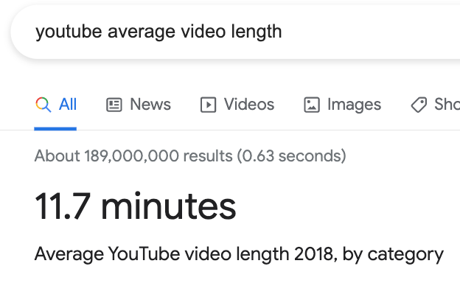
2. Scale of the system - data size
youtube 有20亿用户，DAU 算一半10亿=1000M, 每个人每天看5个跳舞小视频，计算得到
1000M * 5 / 86400 sec = 57k videos/sec
我们默认upload: view比例是1：200，每个上传的视频有200个观看量(我的视频只有100，远远低于平均值大家要加油啊)，我们得到每秒视频上传的TPS
57K / 200 = 285 videos/sec
Storage Estimates: 每分钟视频50m,要保存多格式
300（285）上传速度 * 60 * 10分钟时长 / 60 = 3000小时视频每小时上传
3000hours * 60min * 50m = 9TB/min(150GB/sec)
Bandwidth estimates: 上传3000小时 * 60min * 10mb=1.8TB/min(30GB/sec)
(每分钟视频10mb带宽) 观看速度更夸张*200 = 6TB/s outgoing bandwidth

Slide 5
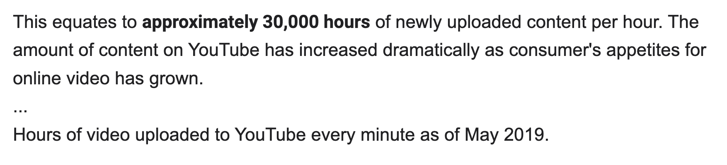
或者我们更简单直接用DAU来推算，大概10%的用户每天上传一个视频，每个视频300mb
1000m* 10% * 300mb = 30000TB daily = 30000TB / 86400 = 300GB / seconds
和我们前面推算的150GB大致相同
通过google，实际数目比我们想的还多10倍

Slide 6
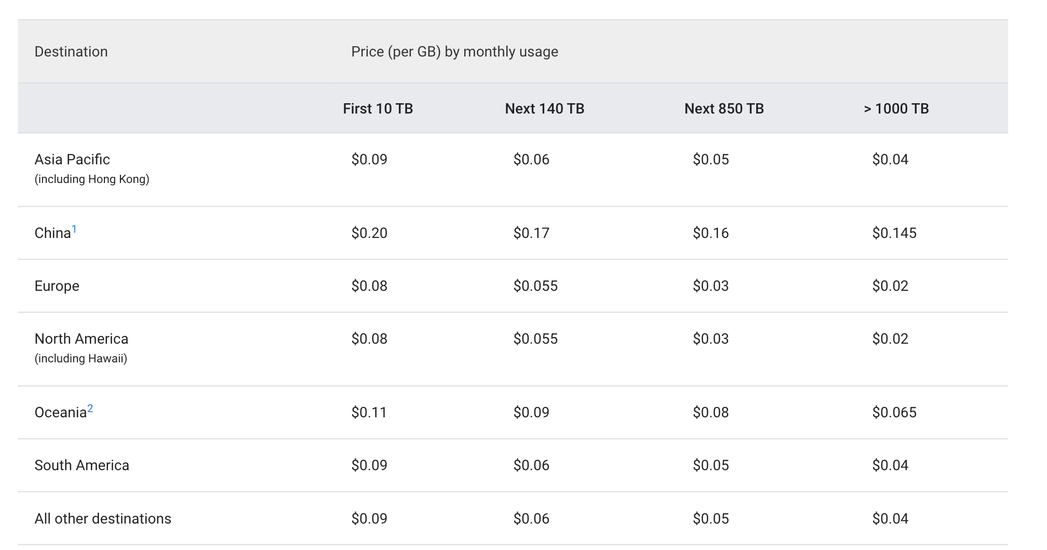
NetFlix use Build its own CDN called OCAs(open connect Applications)
Youtube, Facebook use Akamai’s CDN
Google Cloud CDN or Amazon aws CloudFront CDN per GB $0.02
150GB/s * 0.02$ * 86400 = $ 259,200 per day

Slide 7
API interface
uploadVideo(api_dev_key, video_title, video_description, tags[], category_id, default_language, recording_details, video_contents)
return A successful upload will be HTTP 202
searchVideo(api_dev_key, search_query, user_location, maximum_videos_to_return, page_token)
return A JSON containing information about the list of video resources matching the search query.
streamVideo(api_dev_key, video_id, offset, codec, resolution)
offset: time in seconds from the beginning of the video.
return median stream

Slide 8
如果mySQL, 但是我们后面有trade off
Video table:
VideoID
Title
Description
Size
Thumbnail
Uploader/User
Total number of likes
Total number of dislikes
Total number of views
Video commnet:
CommentID
VideoID
UserID
Comment
TimeOfCreation
User:
UserID
Name
Email
Address
Sex
Age

Slide 9
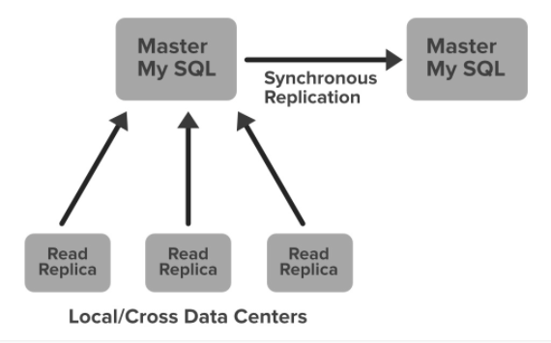
Database, Trade off
Netflix uses two different databases and one Amazon S3.
MySQL(RDBMS) and Cassandra(NoSQL) for different purposes.
Pure video chunks .saved in Amazon S3
EC2 Deployed MySQL
Netflix saves data like billing information, user information, and transaction information in MySQL because it needs ACID compliance. Netflix has a master-master setup for MySQL and it is deployed on Amazon large EC2 instances using InnoDB.
The setup follows the “Synchronous replication protocol” where if the write happens to the primary master node then it will be also replicated to another master node. The acknowledgment will be sent only if both the primary and remote master nodes write have been confirmed. This ensures the high availability of data.
Netflix has set up the read replica for each and every node (local, as well as cross-region). This ensures high availability and scalability.
What is synchronous replication? - Definition from WhatIs.com
DDIA 153页，这里可以展开讲很多，大意是sync可以保证down一个master继续还有其他follower有最新data，二者对比以及semi-sync replication请大家自己翻书，
DDIA yyds

Slide 10
Cassandra 保存历史记录
Cassandra is a NoSQL database that can handle large amounts of data and it can also handle heavy write and read. When Netflix started acquiring more users, the viewing history data for each member also started increasing. This increases the total number of viewing history data and it becomes challenging for Netflix to handle this massive amount of data. Netflix scaled the storage of viewing history data-keeping two main goals in their mind…
Smaller Storage Footprint.
Consistent Read/Write Performance as viewing per member grows (viewing history data write to read ratio is about 9:1 in Cassandra).
Initially, the viewing history was stored in Cassandra in a single row. When the users started increasing on Netflix the row sizes as well as the overall data size increased. This resulted in high storage, more operational cost, and slow performance of the application. The solution to this problem was to compress the old rows…
Netflix divided the data into two parts… (最新的历史记录， 和久远的已经被压缩的历史记录)
Live Viewing History (LiveVH): This section included the small number of recent viewing historical data of users with frequent updates. The data is frequently used for the ETL jobs and stored in uncompressed form.
Compressed Viewing History (CompressedVH): A large amount of older viewing records with rare updates is categorized in this section. The data is stored in a single column per row key, also in compressed form to reduce the storage footprint.

Slide 11
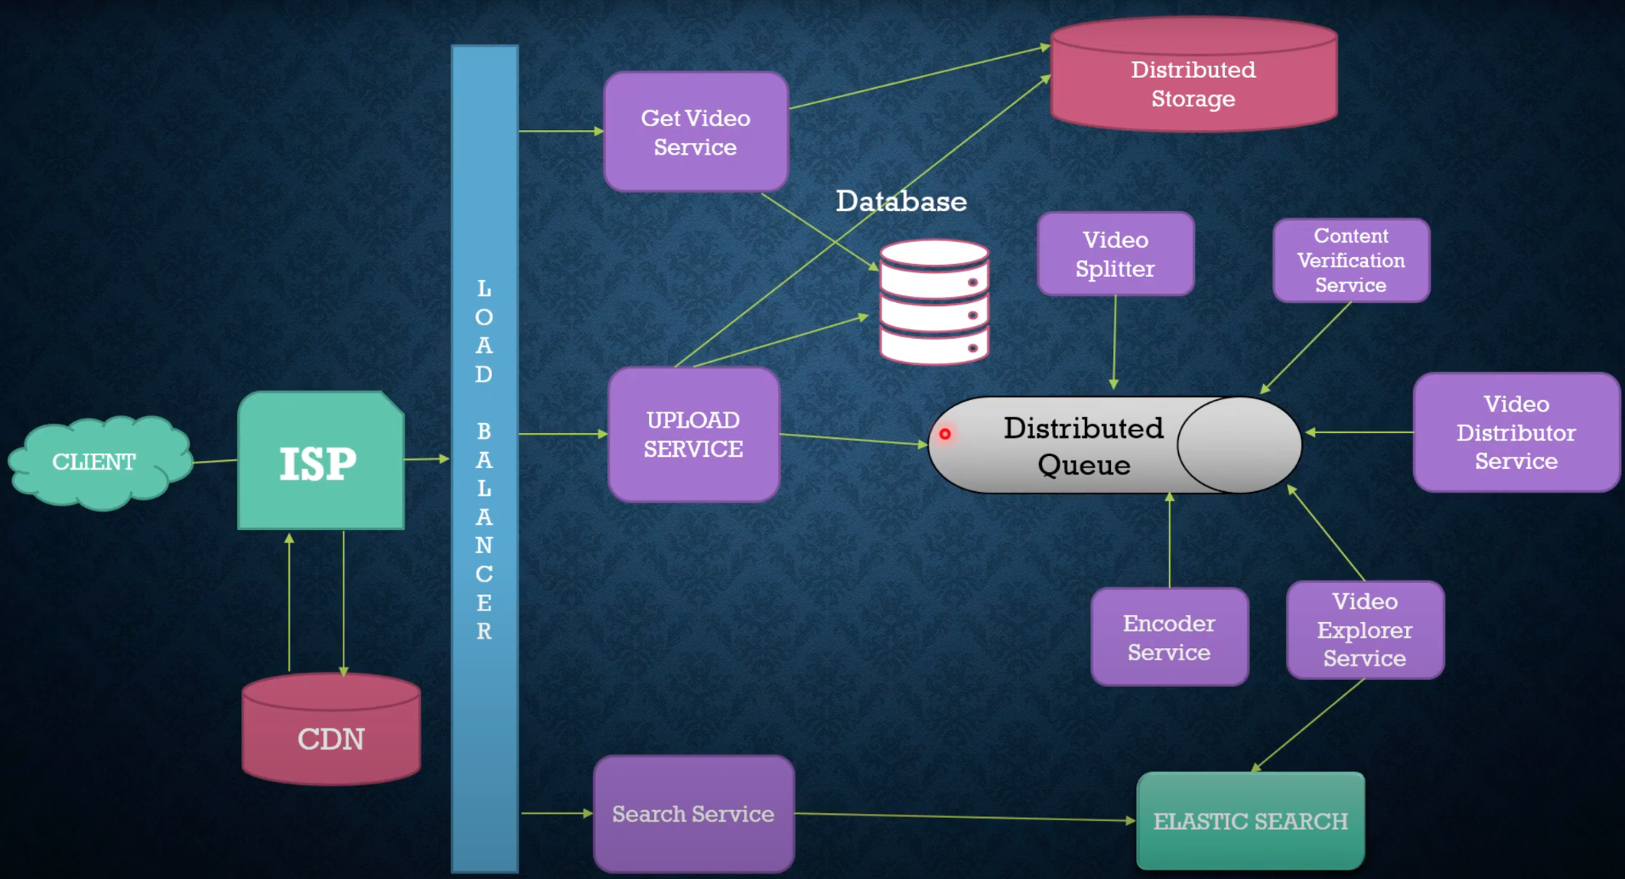
Encoder: To encode each uploaded video into multiple formats.

Slide 12
Detailed Component Design
Read Heavy System.
数据存在HDFS or GlusterFS
我们如何控制这么多的read？ 我们把read, write traffic分开， read可以load balance到不同的机器上，write可以先写到primary/master, secondary/slave慢慢写，略有延迟。write的时候我们先压缩一个480p出来，1小时后再压缩一个1080p, 1440p.
（这里对比bilibili和youtube，b站一次成型速度慢一点，youtube先出小样后高清但是最终品质更好）
DDIA 199页： partition(for write) and replication(for read)

Slide 13
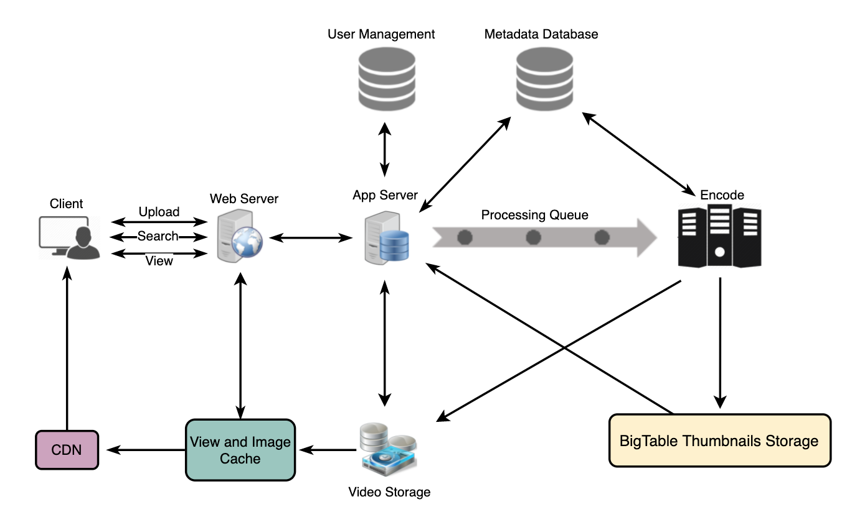
Video Encoding: Newly uploaded videos are stored on the server, and a new task is added to the processing queue to encode the video into multiple formats. Once all the encoding is completed, the uploader will be notified, and the video is made available for view/sharing.
多设备多平台的支持
手机 <> 计算机
为啥我们要encoding？
1.raw video太大了，比如我的原视频都是3GB以上
2.很多设备浏览器只支持特定格式视频
3. 网络卡需要自动标清，流畅
4. 像我这样的1GB网络用户需要提供4k超清
encoding format?
Container: avi, mov, mp4,dash, hls
Codecs: 压缩视频算法 H.264， VP9, HEVC
大视频断点续传加offset，现在切成10s一个chunk.

Slide 14
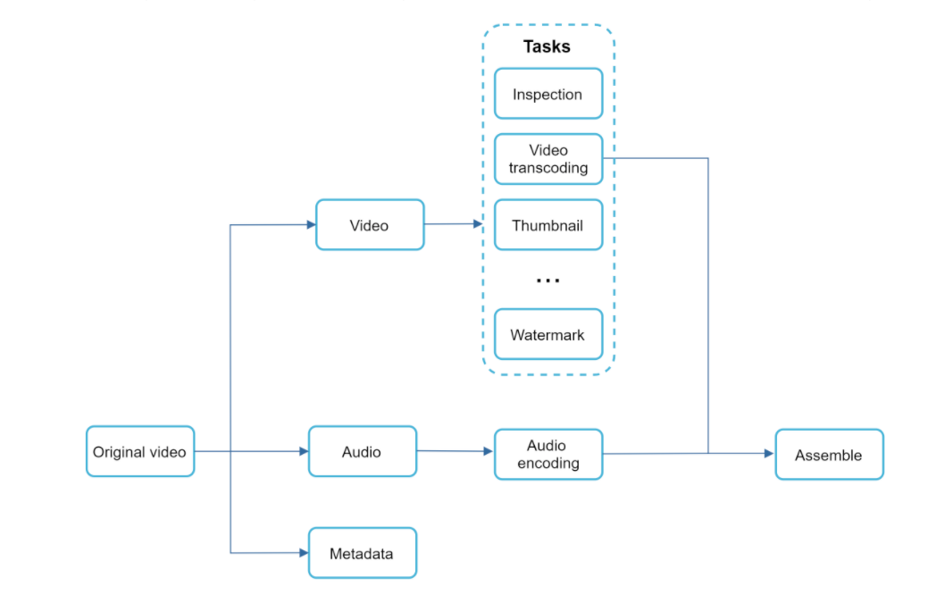
Directed acyclic graph (DAG) model for video encoding 平行处理
新上传视频的一致性
上传之后本地用户很快看到，很远的大洋彼岸的用户无法立即看到，eventual consistent
Directed acyclic graph (DAG) model
Transcoding a video is computationally expensive and time-consuming. Besides, different content creators may have different video processing requirements. For instance, some content creators require watermarks on top of their videos, some provide thumbnail images themselves, and some upload high definition videos, whereas others do not.
To support different video processing pipelines and maintain high parallelism
1.检查有没有少儿不宜
2. 不同分辨率转化
3. 预览图
4. 加水印

Slide 15
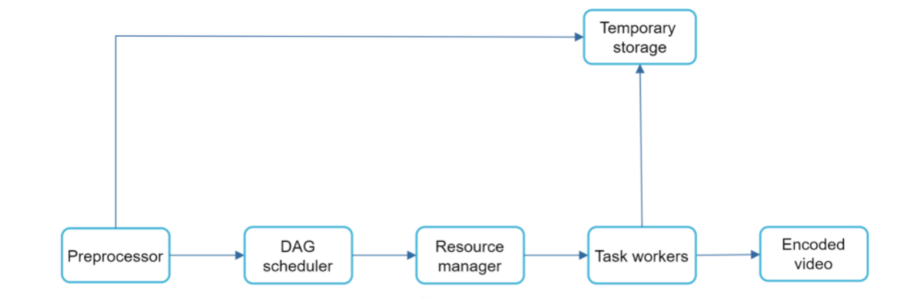
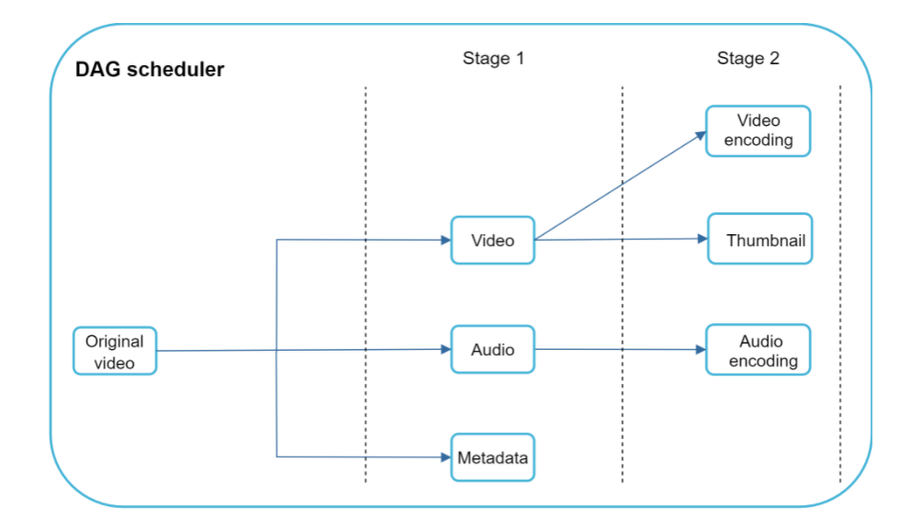
分割视频长度, 或者分割by scence, not by timestamp,这样用户的体验会很好，不会电影高频突然lag.
视频分割成trunk，业界通常都切到10s以内，通常4-7s左右，
分割视频内容并放入queue

Slide 16
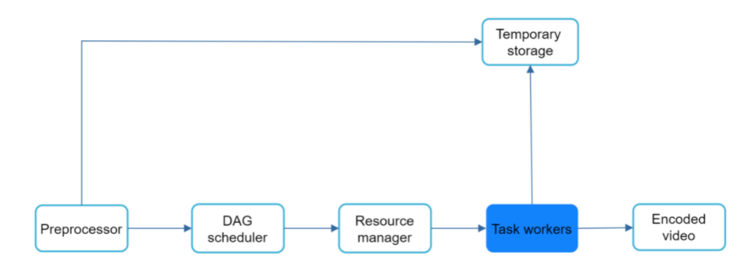
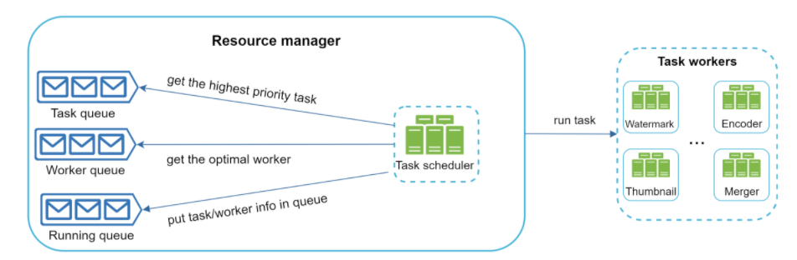
没开始的任务queue
空机器queue
正在二者结合运行的queue
还有一个调度员

Slide 17
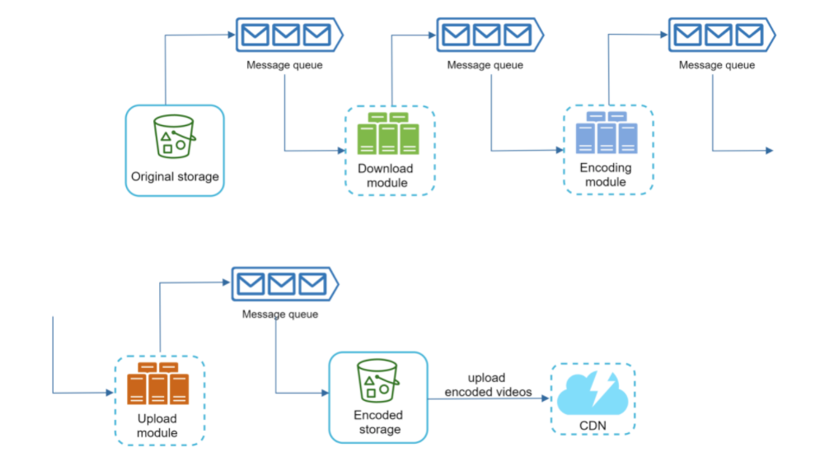
follow up?
视频去重run video matching algorithms，上传时候检查，只补缺的部分(checksum)支持断点续传offset
优化上传速度： 先分割视频，再parallel上传
优化读取速度：全球加更多data center or cdn, 就近。
scale up everything: loosely coupled system
在各个模块之间加message queue
Cost-saving optimization: 只在CDN放热门视频； 不热门的视频我们甚至不需要全格式转换不需要很多分辨率；中文热门视频不需要distribute到美国；你比较吊自己搞一个CDN自己用；根据用户view pattern我们也可以把视频搞变化，比如短视频火我们先搞短的，CDN network traffic才是最贵的部分。优化带宽>优化存储

Slide 18
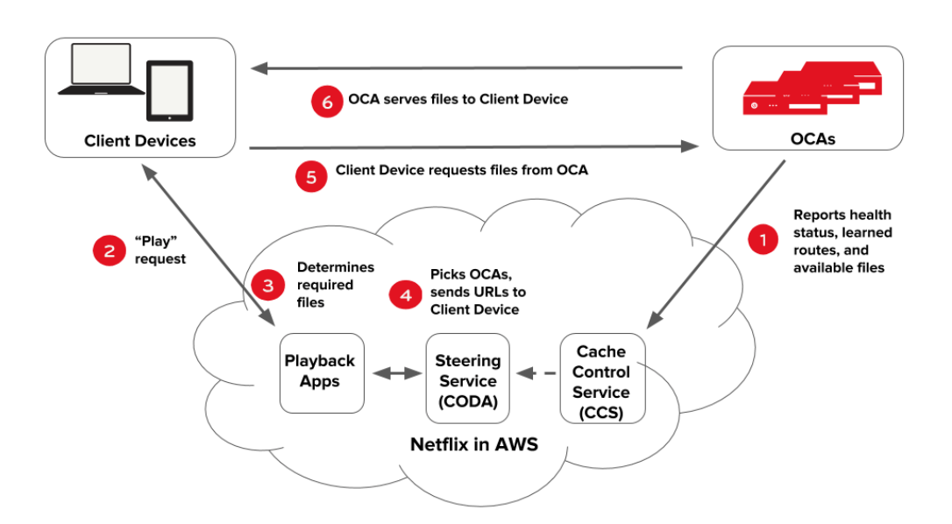
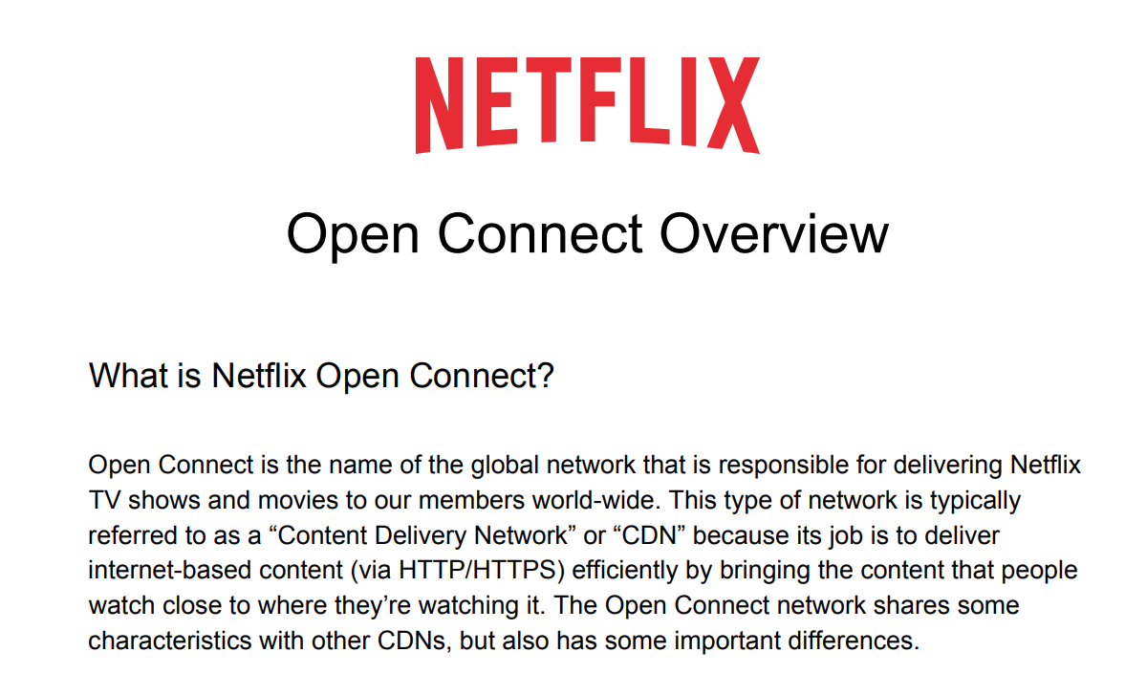
CDN
不同时间可以放入不停的主题的cache，95%的traffic是从OCAs来的
Open Connect Overview

Slide 19
Error handling
可以try的：比如encode错误，多次取消
不可retry的比如用户传了个病毒，我们就停止
API server down, 我们有consistent hashing下一个机器上
DB server down: master is down我们再选一个master从slave里 slave is down, 再起一台机器替换，同时隔壁slave来替代读

Slide 20
Metadata Sharding distribute our data onto multiple machines wisely
Sharding based on UserID:
一个用户保存在一个server
好处：看一个用户的视频很快
坏处：1. 搜索视频名字老费事了，需要query所有server。
2. 爱豆又来了，名人怎么办？单台机器立马拉胯
3. 以后有的人储存的多，有点人储存的少，不好distribute growing user data, moving data is costly.
Sharding based on VideoID:
好处：找单个视频快
坏处：找一个用户所有视频慢，另外还有popular videos 问题，当然我们也可以加cache
Scale the database: You can talk about database replication and sharding.

Slide 21
Summary:
知识点过多，感觉核心得分点：
视频上传data flow
视频处理video encoding
看视频- CDN
视频搜索，db sharding trade off, Elastic Search

Slide 22


通讯页面
Bilibili https://space.bilibili.com/21630984
Youtube 搜索古城算法
https://www.youtube.com/c/古城算法
wechat 回复‘加群’可加群
谢谢大家的支持！请点赞订阅硬币
500订阅会出一期dp总结篇
免费，不要钱，不卖课，不推销，不辅导，公开资料和视频，任何人和你说钱都是骗子！

Slide 23
reference
Netflix System Design | System Design YouTube | System Design Video Streaming App
Design youtube
https://openconnect.netflix.com/Open-Connect-Overview.pdf
https://www.youtube.com/watch?v=NBO88PLGIis&ab_channel=TheTechGranth

